Slide 1
Predicting Airline Delays
Vishesh Saharan

Slide 2
The Problem
Airline delays hurt both the passenger and the company, as it can be a personal inconvenience for the passenger and can result in the disruption of efficient operations.
Using the data provided from Kaggle, I would like to predict airline delays. By using this analysis, one would be understand the key factors contributing to these delays and avoid them in the future
We will try and predict the arrival time between the departure airport and arrival airport

Slide 3
What could we do with this?
This information regarding flight delays or early arrivals can be utilized to make informed decisions.
Travelers can make decisions as to which airlines they should avoid.
Airlines can use this information to improve their planning and services.
Decisions regarding exit gate numbers
Adjusting parking spaces

Slide 4
The Data
The Kaggle dataset includes 20 different columns with over 1million entries of airline flights in 2019 regarding airline delays. I intend to analyze nearly all of them
The Kaggle dataset has a large number of missing values, there are data format issues that will make the data set more unclean for analysis
Time in hhmm format. Will need to convert to minutes and then to proper hr:min format
CARRIER_DELAY, WEATHER_DELAY, SECURITY_DELAY, NAS_DELAY, LATE_AIRCRAFT_DELAY, SECURITY_DELAY are the columns with maximum number of missing values
Missing values are present not because of the bad quality of data but due to the fact that these instances never occurred.
Some rows have NA values for all columns, these will be removed

Slide 5
Data Exploration
Which airlines have the most delays?
Top 5(Worst): JetBlue, Envoy Air, ExpressJet, Allegiant, Frontier
Bottom 5(Best): Delta, Spirit, Endeavor Air, Southwest, PSA
Which airports have the most delays?
Top 5 Worst: PIB(Hattiesburg, LA),MEI (Meridian, LA), EAU (Eau Claire, WI), ALO (Waterloo, IA), MKG (Muskegon, MI)
Top 5 Major Airports (Worst): LGA(LaGuardia, NYC), EWR(Newark, NJ), SFO (San Francisco, CA), ORD (Chicago, IL), BOS (Boston, MA)
Bottom 5 Major Airports(Best): PHL (Philadelphia, PA), BWI (Baltimore, MD) , ATL(Atlanta, GA), DTW (Detroit, MI), IAD (Dulles Intl, VA)
What time of year has the most delays?
Top 10 dates all fell between 1/21/2019 and 2/22/2019.

Slide 6
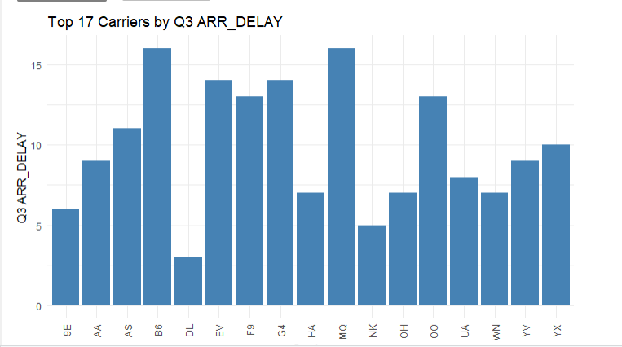
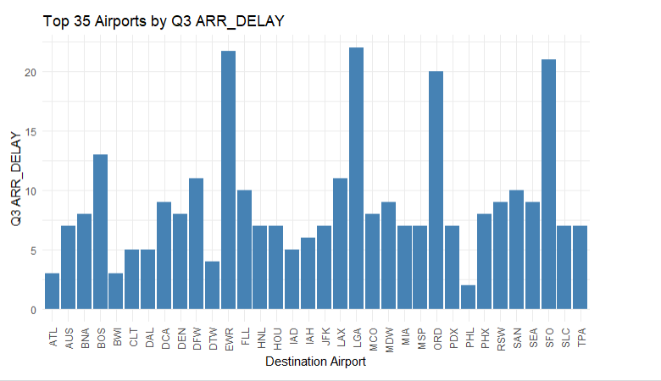
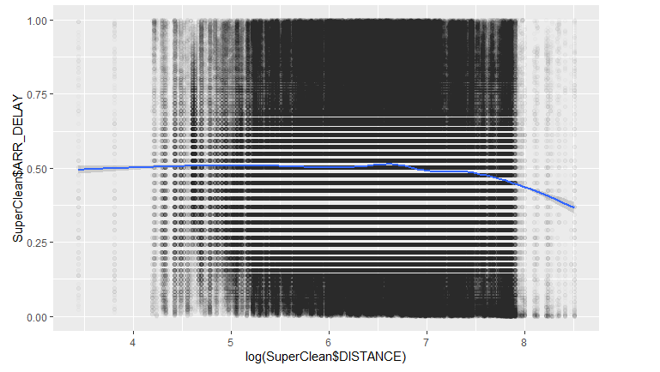
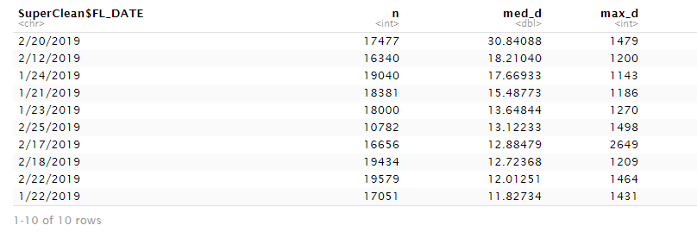

Slide 7
The Techniques
For my predictions, I will aim to compare Random Forest, Extreme Gradient Boosting, and Multiple Linear Regression models and see which one provides a more robust and accurate model.
Multiple Linear Regression: Linear regression model over multiple explanatory variable. Use of linear predictor functions to fit a predictive model on an observed dataset
Random Forest: Use of decision trees. Can be thought of as an algorithm that creates numerous decision trees and combines them all together to spit out a more accurate and stable prediction.
Extreme Gradient Boosting : Based on boosting algorithms. The base learners of XGBoost are classification and regression trees (CART). Each tree produces a different prediction score which is dependent on the data it sees and the scores from each tree are summed to get the final score.
Why these techniques?
Allows for multiple factors to be studied
Seasonality, Distance, Departure Delays, etc

Slide 8
Experiment
MLR: The target variable is arrival_delay, but we will use departure_delay and distance as our predictor variables . Use of training and testing dataset with 70% in training, and 30% in testing. Use of library(carets) to create training and testing subset.
Random Forest: Since our target variable is also arrival delay is a continous variable we can use Random Forest Regression. Using almost all variables excluding arrival_delay as predictor variables. Use of training and testing subsets with 66% in training and 34% in testing. 100 trees used
Extreme Gradient Boost: Use of the mutate_if and mutate_at functions in R to create factors that will work in the regression. Use of training and testing subsets in Random Forest, but with tuned parameters. Use of xgboost library to assist with regression and assessing model on the same scores as Random Forest. 500 rounds used
For the predictions, I will use the predict() function in R and fit the regressor to the training set and test dataset
For assessing the model, I will consider the R-squared value and Root Mean Squared Error ( RMSE value) and apply it to my prediction data. This will allow us to see the quality and accuracy of the model.
We then will be able to see which model provides more accurate predictions and ultimately make a conclusion on which test is superior and what the airlines could do to avoid delays moving forward.

Slide 9
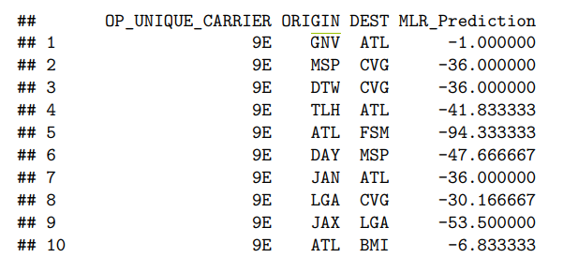
Results
MLR:
R² : 0.2173564
RMSE: 246.0989
Moderate speed
Predicts mostly early arrivals vs. later arrivals- 67% vs. 32%
Poor trend between predictor variables and observed data and strongly overfitted

Slide 10
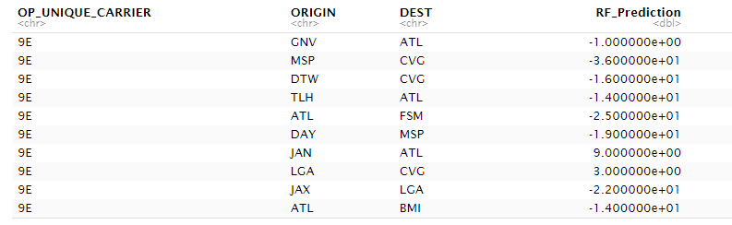
Results(cont.)
Random Forest:
R² : 0.1551818
RMSE: 1.44102
Slowest
Better distribution between early arrivals vs. late arrivals-64% vs. 36%
Poor trend between predictor variables, but better prediction fit.

Slide 11
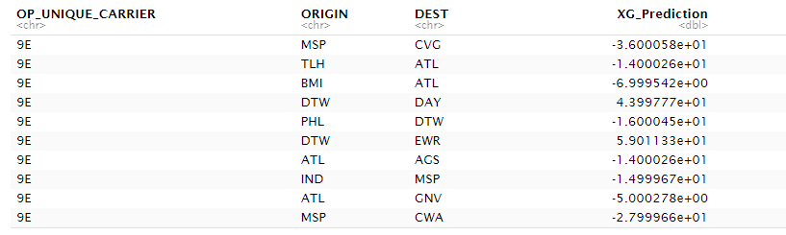
Results(cont.)
XGBoost:
R² : 0.348169
RMSE: 0.6759
Fastest
Better distribution between early arrivals vs. late arrivals -64% vs. 36%
Better predictive trend and better predictive fit

Slide 12
Conclusions
Not the best models out there
All R² values < 0.5
RMSE values > 0.5
XGBoost does appear to be the stronger model.
Most accurate to training/testing split
Followed by RF, and then MLR
Why the subpar results?
Not enough data
Too many predictor variables
Future Work?
Bootstrapping, especially in Random Forest
Hyperparameter Tuning, especially in XGBoost

